Slide 1
CARGURUS.COM
Selenium automation TESTing PRESENTATION

Slide 2


Slide 3
INTRODUCTION
In this Project we are performing end-to-end quality assurance automation task using various Functional and Selenium Web driver testing tools.
This Presentation describes testing framework and tools worked with. Software testing is a critical element of software quality assurance and
represents the ultimate review of specification, design, and coding. Test Automation is the best way to increase the effectiveness, efficiency
and coverage of our software testing. Test objectives are to provide adequate coverage metrics and requirements validation to verify that the functionality of CARGURUS works as expected.

Slide 4
OVERVIEW OF THE CarGurus
CarGurus is a global, online automotive marketplace connecting buyers and sellers of new and used cars and third party administration.
Using proprietary technology, search algorithms, and innovative data analytics, CarGurus provides unbiased insights on car pricing, dealer reputation, and vehicle history.
For used vehicles calculates a fair retail price based on a detailed analysis of comparable current and previous car listings in a given market

Slide 5
Data exchange system:
CarGurus
Dealers
Consumers
Employees
Third Party Administration
Private Sellers

Slide 6
Website Modules:
USER

Slide 7
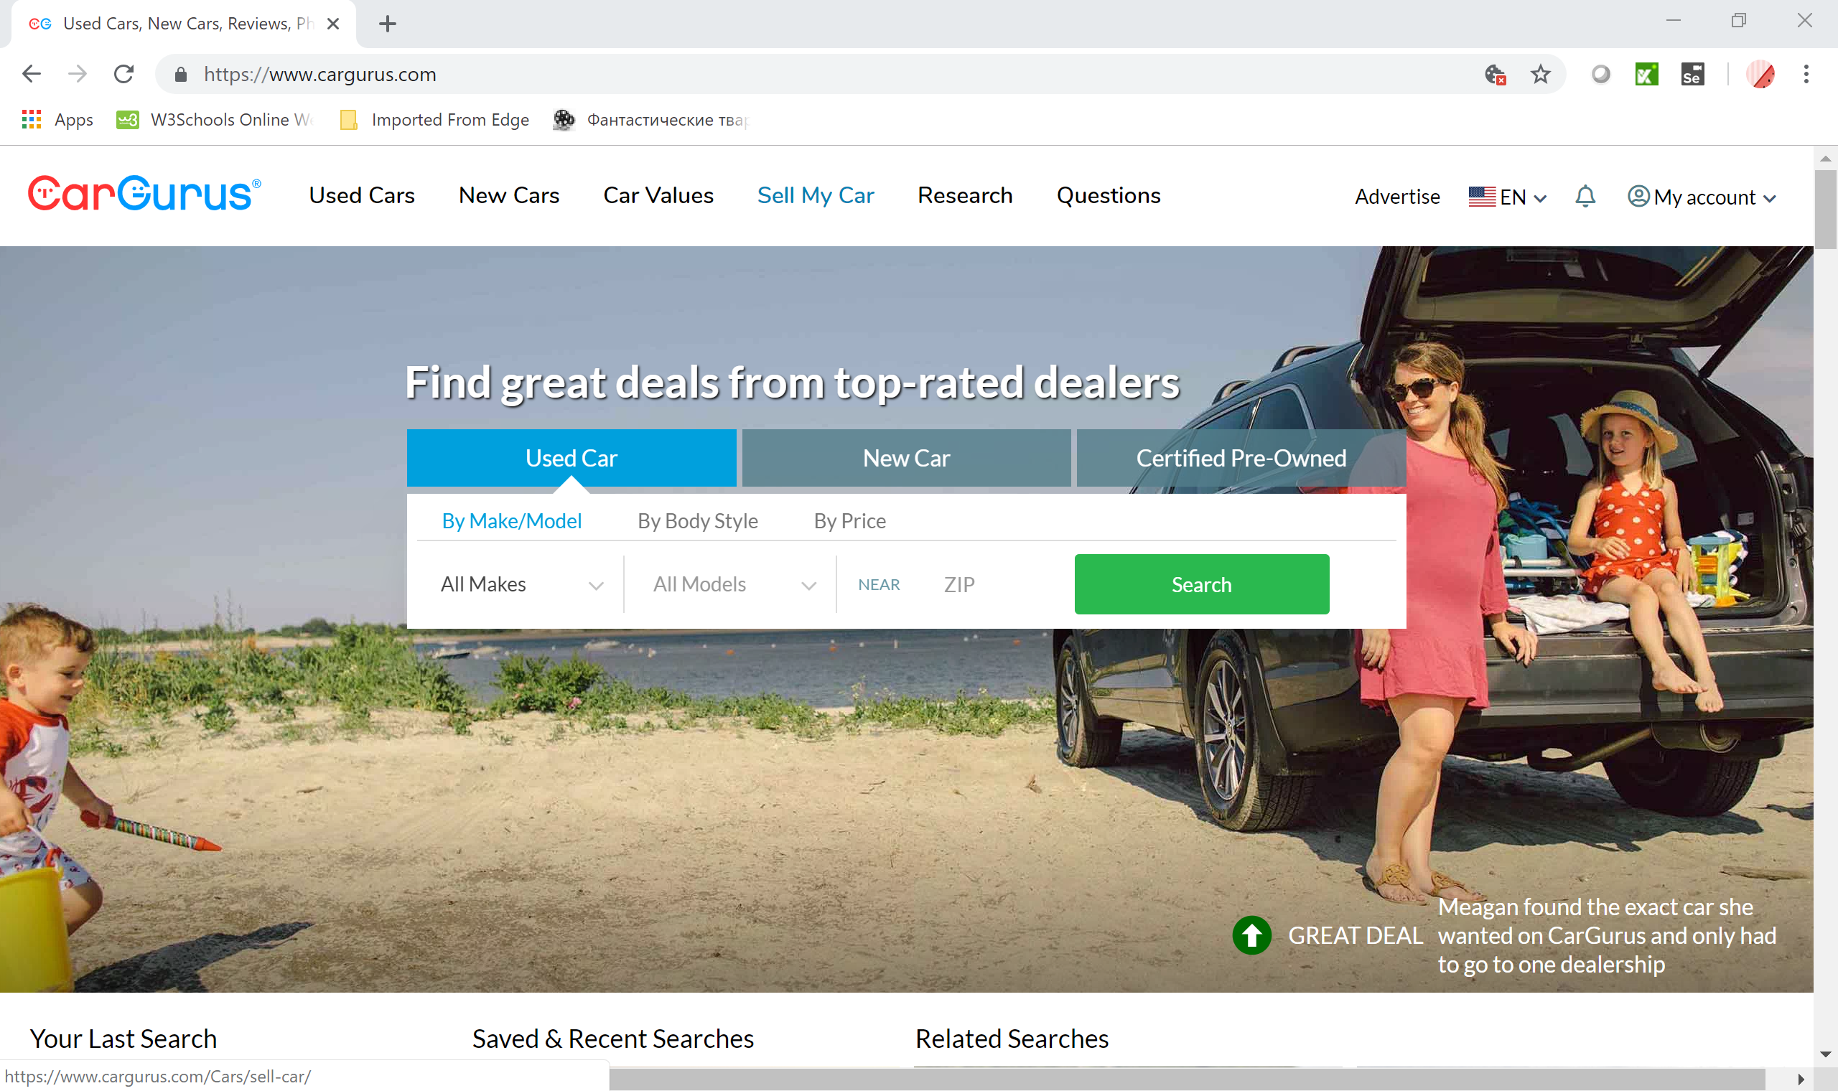
Website interface
Website has a home page with select boxes for used cars, new cars and certified Pre-owned.
This page has the option for login and password for registered users. For new customers has clickable link and helpline in order to create a new account or sign up using existing Facebook or google account.

Slide 8
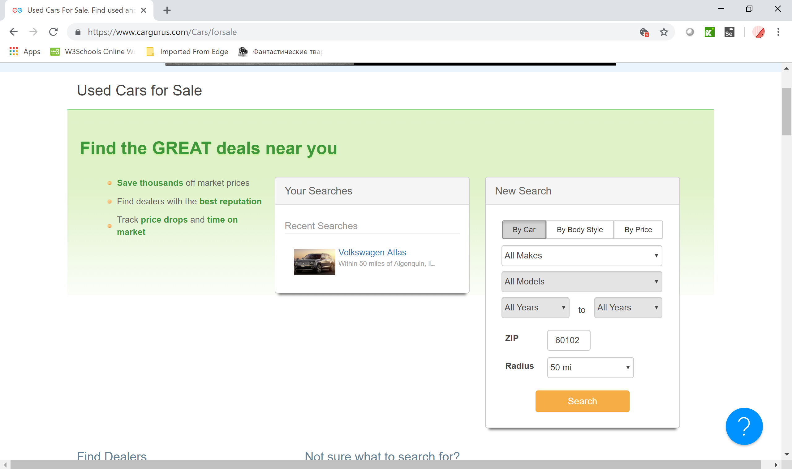
USED CARS FOR SALE SEARCH ENGINE

Slide 9
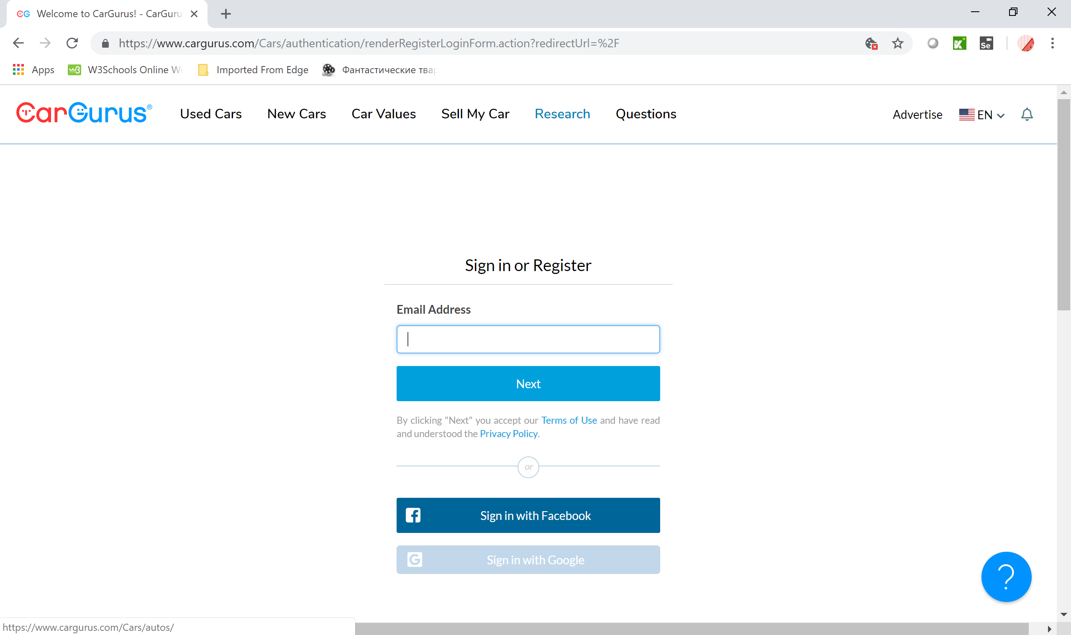
SIGN IN OR REGISTER PAGE

Slide 10
TEST PLAN
Introduction
Features To Be Tested
Features Not To Be Tested
ENTRY AND EXIT CRITERIA
TEST APPROACH
Pass / Fail Criteria
Testing Process
RISK AND ASSUMTIONS

Slide 11
Introduction
Software testing is a critical element of software quality assurance and represents the ultimate review of specification, design, and coding. Test Automation is the best way to increase the effectiveness, efficiency and coverage of our software testing.
Test objectives are to provide adequate coverage metrics and requirements validation to verify that the functionality of CARGURUS works as expected.
SCOPE OF THE PROJECT:
CARGURUS will be tested for its functionality to ensure proper application navigation, data entry, processing, and retrieval.

Slide 12
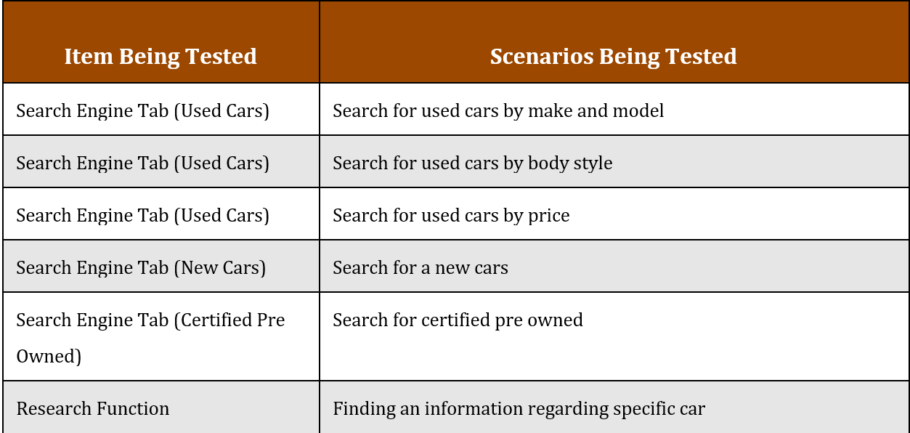
Features To Be Tested

Slide 13
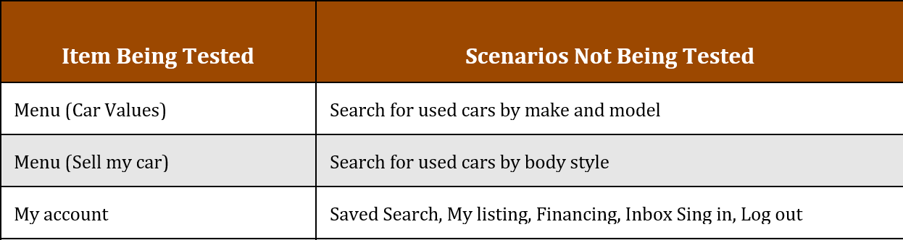
Features Not To Be Tested

Slide 14
Entry and Exit criteria:
Entry criteria:
Complete or partially testable code is available.
SUT is defined and approved.
Availability of sufficient and desired test data.
Test environment has been set-up and all other necessary resources such as tools and devices are available.
Test Plan, Test Cases and Test Data are developed and written.
Exit criteria:
Deadline is met.
Execution of all test cases.
Achieving complete Functional Coverage.
No high priority or severity or critical bug has been left out.
System’s compatibility with supported hardware and software is checked.

Slide 15
TEST Approach
TEST LEVEL:
SYSTEM TESTING
TEST TECHNIQUES:
BLACK BOX (EP, BVA,USE CASE)
EXPERIECE BASED(ERROR GUESSING, EXPLORATORY TESTIG )
WHITE BOX (STATEMENT TESTING AND DECISION TESTING)
TEST TYPES:
FUNCTIONAL
WHITE BOX
TEST STRATEGY:
ANALYTICAL

Slide 16
Pass / Fail Criteria
PASS CRITERIA:
Testing is considered successfully completed only when:
All the major functionality of the application is confirmed to be working as intended
The test coverage should be 100%
The pass percentage of test cases should be more than 95%
There should not be any critical bugs
FAIL CRITERIA:
Testing fails if any of the pass criteria is not met

Slide 17
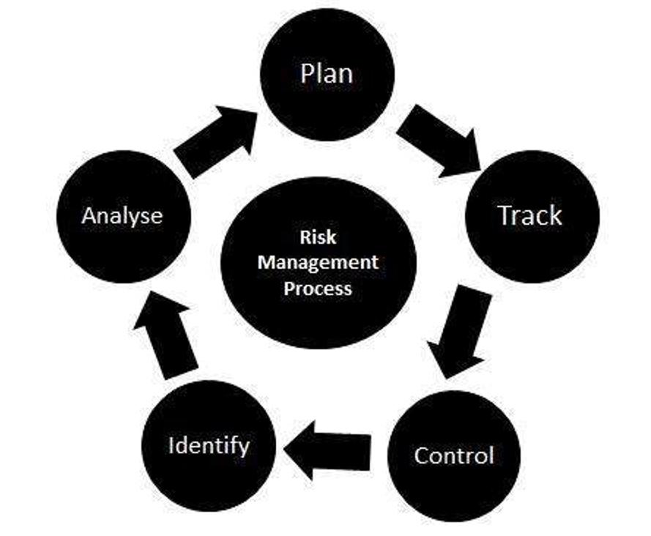
RISKS
Integrity level is 1 (negligible)
According to IEEE829 mitigation in this level of integrity is not required but for this project is going to be used since it’s the first project for this team. Risk – Wrong time estimation to complete testing or the whole project.
Mitigation plan – Establish the scope before beginning the testing tasks and pay attention in the project planning and also track the time estimates constantly.
Risk – Improper training or lack of knowledge of team members.
Mitigation plan – Team lead or manager has to make sure that a team member has required knowledge to complete the task before assigning it. If the task can not be assigned to a different team member make sure that this team member gets proper training from the rest of the team, manager or from ITExperts staff.
Risk – Product is too complex to test.
Mitigation plan – Carefully prepare a test plan. Develop and execute manual testing first. If during designing, developing or executing automation 30% of test can be implemented then the scope of the test plan may be changed

Slide 18
Test Processes
TEST PLANING
TEST MONITORING AND CONTROL
TEST ANALYSIS (what to test)
TEST DESIGNE (how to test)
TEST IMPLEMENTATION (do we have everything to run tests)
TEST EXECUTION
TEST COMPLETION

Slide 19
The stakeholders
Dealers;
Private Sellers;
Customers;
Employees;
Third Party;
Owners;

Slide 20
Roles and responsibilities
Role | Minimum Resources Recommended (number of workers allocated full-time) | Responsibilities/Comments
QA Lead | 1 | Prepare Test Plan
QA Manager | 1 | Provides management oversight Responsibilities: Provide technical direction Acquire appropriate resources Management reporting
QA Engineer | 4 | Execute testing process Responsibilities: Write Test Cases Execute Test Cases manually Execute Test Cases using automation tools Write Bug Reports

Slide 21
PROJECT milestoneS
Task | Volume of work | Starting Date | Expiration Date
Test Plan Creation | 4 days | 01.15.2019 | 01.19.2019
SetUp Enviroment | 2 days | 01.19.2019 | 01.22.2019
Writing Test Cases | 7 days | 01.23.2019 | 02.01.2019
Automation test Execution | 7 days | 02.04.2019 | 02.13.2019
Analysis of Testing | 3 days | 02.14.2019 | 02.18.2019
Presentation Date |  |  | 02.19.2019

Slide 22
During the Automation Testing process the following application functions will be tested:
Search for used cars
Search for new cars
Search for pre-certified cars
Different types of the decision making tools like car values, questions.

Slide 23
The table sets of hardware and software resources for the testing Website:
OS WINDOWS
BROWSER
GOOGLE CHROME,
Firefox;

Slide 24
Methods, approaching validate the data
The identification of functions that the software is expected to perform
The creation of input data based on the function's specifications
The determination of output based on the function's specifications
The execution of the test case
The comparison of actual and expected outputs
To check whether the application works as per the customer need

Slide 25
Automation testing process
The following functions will be tested:
Interface page clickable boxes [used, new, pre….]

Slide 26
TECHNOLOGIES WERE USED:
JAVA
JUNIT
MAVEN
SELENIUM WEBDRIVER
KATALON IDE
JENKINS
SELENIUM GRID
NETBEANS
GIT
GITHUB
DATA DRIVEN TESTING

Slide 27
Test data
Automated testing is a process to validate that software functions appropriately and meets requirements before it is released into production. Automated testing tools execute tests, report outcomes and compare results with earlier test runs.
Principles of Software Testing:
Exhaustive testing is impossible
Testing is context dependent
Absence of error
Pesticide paradox

Slide 28

Katalon ide
Katalon Recorder helps record, play, debug, manage automated tests, and export to C#, Java, Ruby, Python, Groovy, or Robot Framework

Slide 29
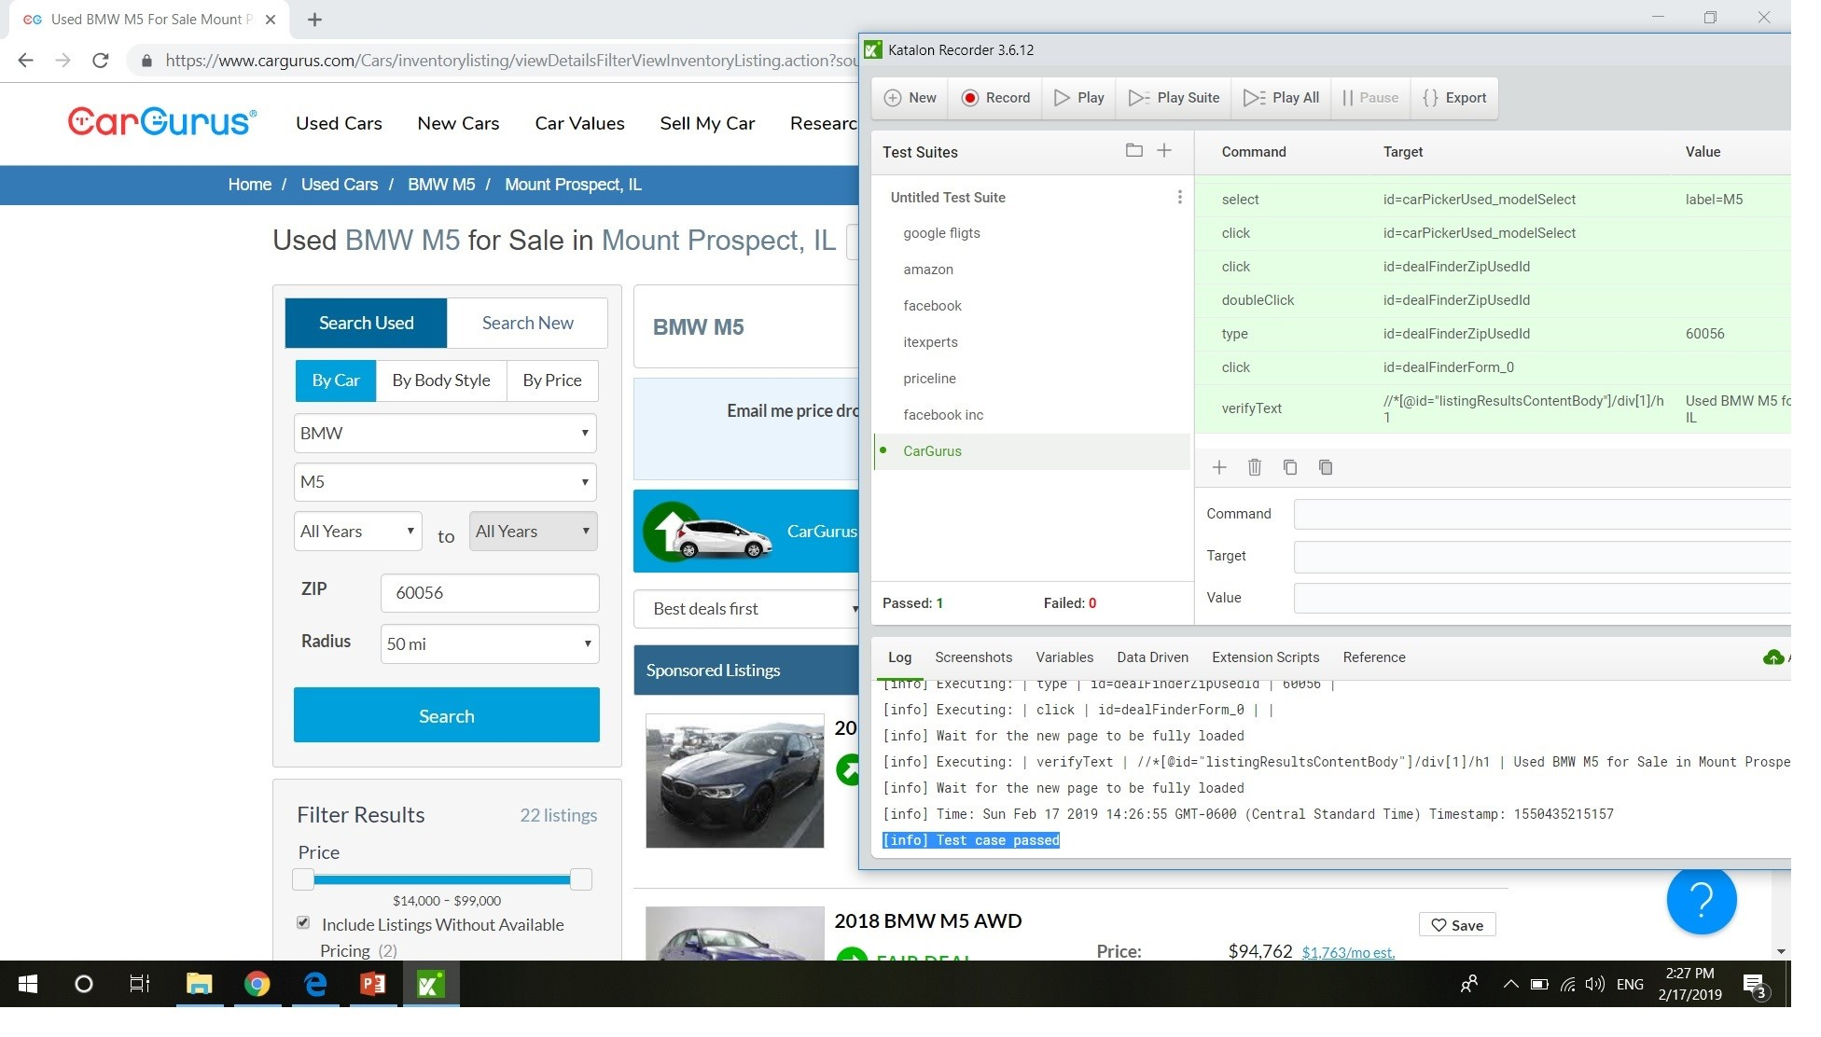
KATALON IDE RECORD AND PLAY

Slide 30
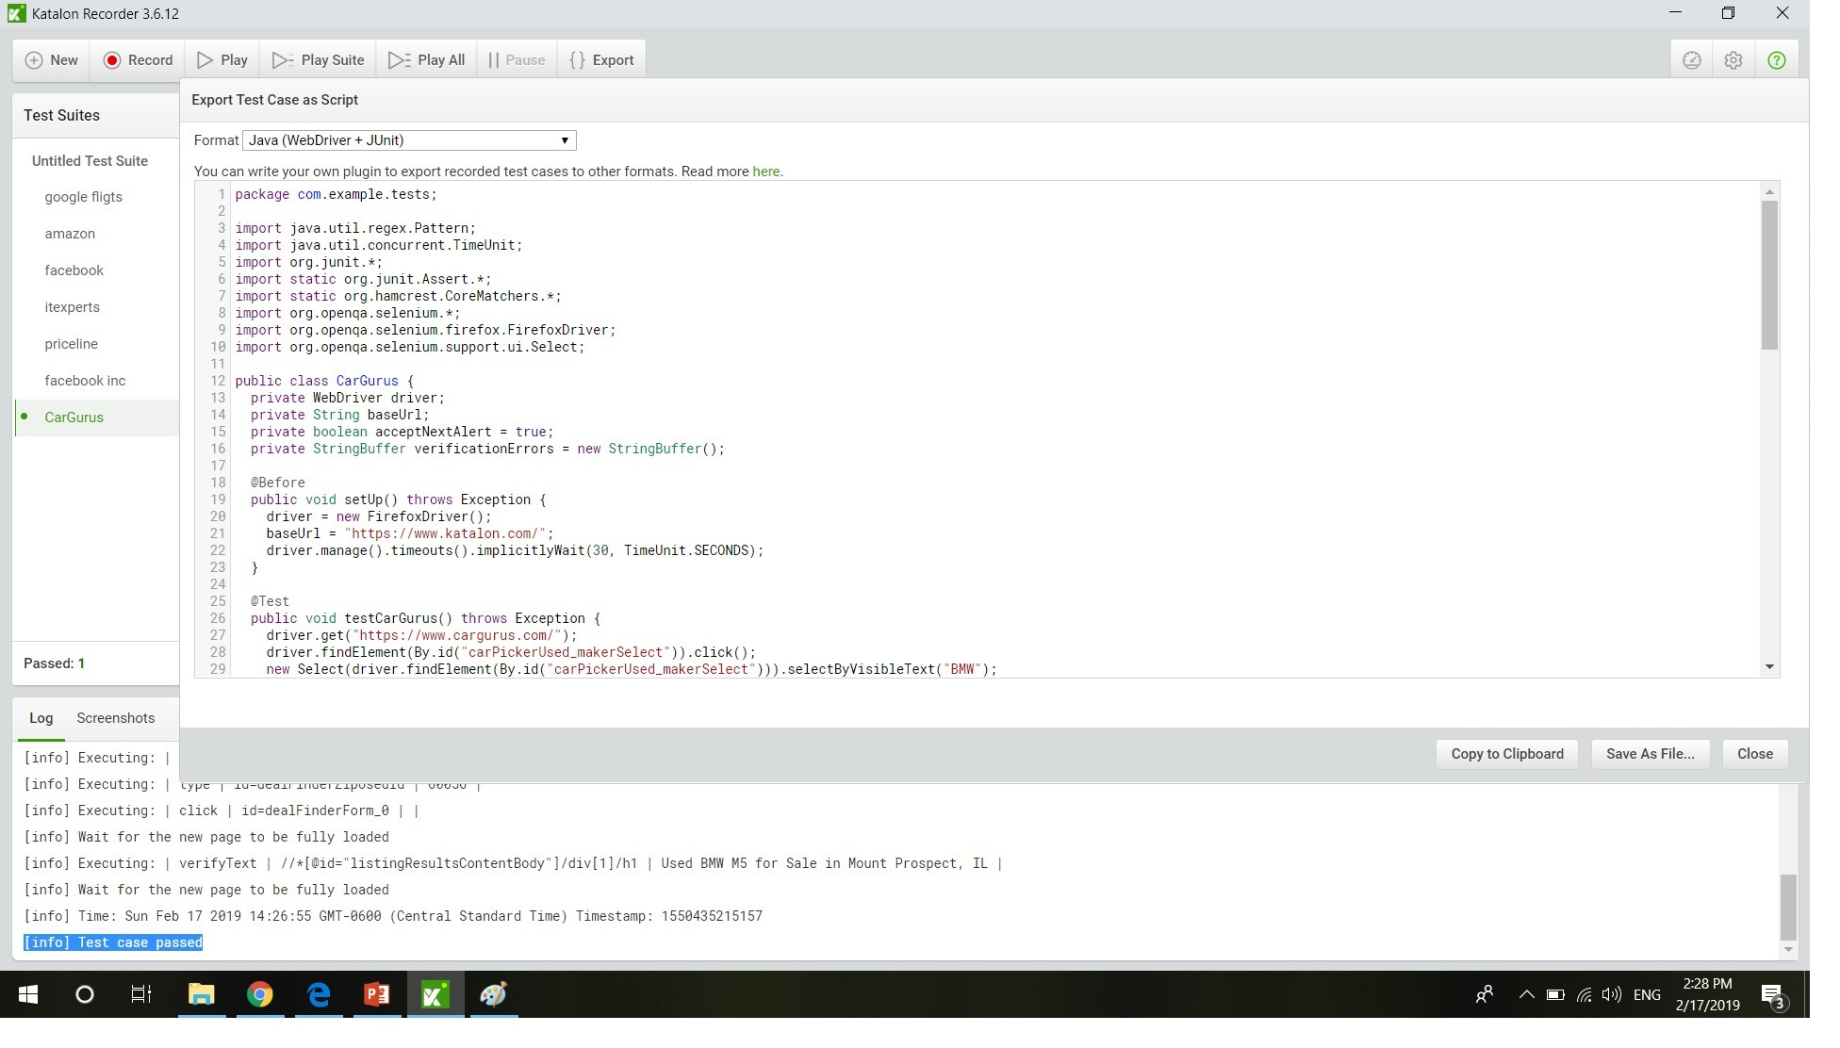
KATALON IDE EXPORT

Slide 31
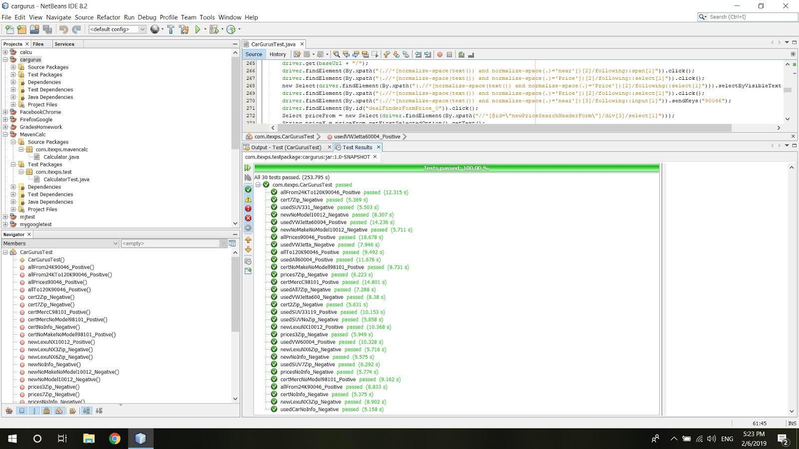
EXECUTION OF THE SCRIPT

Slide 32
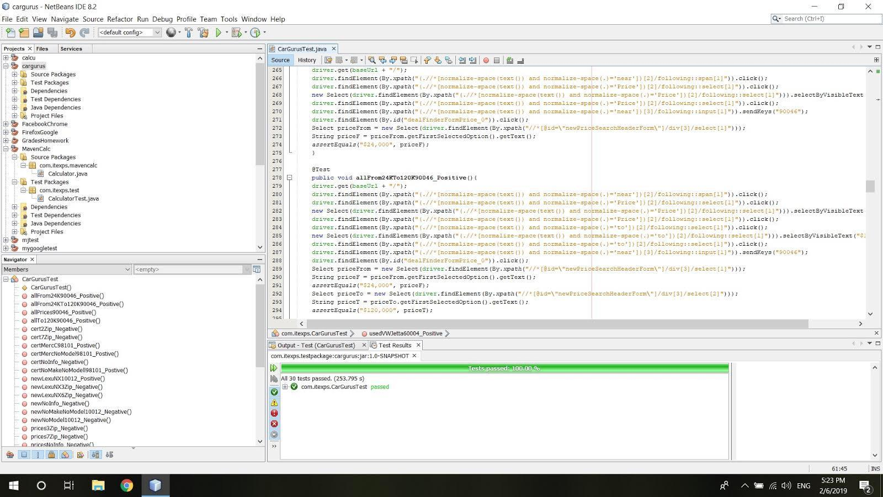

Slide 33
SELENIUM
Selenium automates browsers. It is for automating web applications for testing purposes.
Selenium WebDriver
creates robust, browser-based regression automation suites and tests scale and distribute scripts across many environments

Slide 34

Dependency management
Build lifecycle management
Large existing repository
Build process is standardized for all projects
Easy to plugin to CI, You can run the same build locally and via a ci tool like Jenkins by setting up a maven build job

Slide 35

JUnit is an open source framework designed for the purpose of writing and running tests. Junit Provides:
Annotations to identify test methods assertions for testing expected results test runners for running test
Allows you to writes code fasten
Increases QUALITY
Simple
Less time
Tests can be run automatically
Test suites
Test progress

Slide 36

Selenium webdriver
Selenium-WebDriver makes direct calls to the browser using each browser’s native support for automation. How these direct calls are made, and the features they support depends on the browser you are using.

Slide 37

Jenkins is an open source automation server written in Java. Jenkins helps to automate the non-human part of the software development process, with continuous integration and facilitating technical aspects of continuous delivery.

Slide 38


NetBeans is an integrated development environment (IDE) for Java. NetBeans allows applications to be developed from a set of modular software components called modules

Slide 39

Git is a free and open source distributed version control system designed to handle everything from small to very large projects with speed and efficiency.

Slide 40

GitHub is a web-based version-control and collaboration platform for software developers. Git is used to store the source code for a project and track the complete history of all changes to that code. It allows developers to collaborate on a project more effectively by providing tools for managing possibly conflicting changes from multiple developers.

Slide 41
Data driver testing
Data-driven testing (DDT) is a software testing methodology that is used in the testing of computer software to describe testing done using a table of conditions directly as test inputs and verifiable outputs as well as the process where test environment settings and control are not hard-coded. In the simplest form the tester supplies the inputs from a row in the table and expects the outputs which occur in the same row.

Slide 42
CONCLUSION
CHALLENGES

Slide 43
The project was created and presented by the group of ITEXPS students:
1 GRIGOR NIKOLOV
2 ALEXANDER BALBUS
3 SERGEI GAPANOVICH
4 JURGITA NARVILIENE
© ITEXPS_Students, 2019

